Slide 1
Chapt3_1
Arithmetic for computer

Slide 2
Contents
1 Signed and Unsigned Numbers-Possible Representations
2 Arithmetic--Addition & subtraction and ALU
3 Multiplication
4 Division (chap3_2)
5 Floating point numbers (chap3_2)

Slide 3
Introduction
Computer words are composed of bits;
words can be represented as binary numbers.
There are 32bits/word or 64bits/word in RISC V
Simplified to contain only in course:
memory-reference instructions: lw（load word）, sw(save word),
arithmetic-logical instructions: add, sub, and, or,xor, sll, srl,sra,slt, sltu无符号位
control flow instructions跳转: beq, bne, blt, bge, jal无条件, jalr
Generic Implementation:
use the program counter (PC) to supply instruction address指示地址
get the instruction from memory
read registers
use the instruction to decide exactly what to do
All instructions use the ALU after reading the registers

Slide 4
For binary integer
The following 4-bit binary integer What does it mean?
1001₂
Don’t know!
Integer representation of different methods have different meaning
Unsigned 1001₂=9₁₀
Signed 1001₂=-1₁₀ or -7₁₀ ?
（原码）
（补码）

Slide 5
Numbers and their representation
r进制数
MSB
LSB
原码、反码在数轴上对称，两者都存在+0和-0两个0
补码、移码在数周上不对称，0唯一，比原码、反码多一个数

Slide 6
B转O,H
左右补0凑位
D转任意
整数除基取余，小数乘基取整
之后验证一下是不是对的
注意小数是离散的，所以不是每个十进制小数都可以有准确地用二进制表示

Slide 7
Numbers and their representation
Representation
ASCII - text characters
简单的数字读写
复杂算术(按字符计算)
Binary number
Natural form for computers
Requires formatting routines for I/O
* ASCII--American Standard Code for Information Interchange
8bit

Slide 8
Number types
Integer numbers, unsigned
Address calculations 地址
Numbers that can only be positive 数量
Signed numbers
Positive
Negative
Floating point numbers
numeric calculations 数值计算
Different grades of precision
Singe precision (IEEE) 单精度
Double precision (IEEE) 双精度
Quadruple precision
真值转换为补码：对于正数，与原码的方式一样。对于负数，符号位取1，其余各位由真值“各位取反，末位加1”得到
补码转换为真值：若符号位为0，与原码的方式一样。若符号位为1，真值的符号为负，数值部分各位由补码“各位取反，末位加1”得到

Slide 9
补码
如果字长为n+1
fraction
比原码多-1
integer
比原码多

Slide 10
补码的优势
0唯一
运算简单，符号位可以和数值位一起运算（加减法可以一起运算）
可以多表示1个数

Slide 11
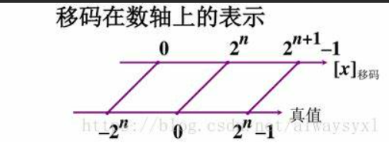
Two‘s Biased notation 移码表示法
真值x的基础上加一个常数（置偏值），通常为
全是正的
机器字长为n+1
移码方便浮点数科学计数法
Negating Biased notation number:
2's Biased notation VS 2's complement
X=＋1011 [X]c=01011 [X]b=11011
X=－1011 [X]c=10101 [X]b=00101
补码和移码只差一个符号位

Slide 12
Compare operations
Different compare operations required for both number types
Signed integer
slt Set when less than 寄存器与寄存器，前小于后1
slti Set when less than immediate寄存器与立即数，前小于后1
Unsigned integer
sltu Set when less than
sltiu Set when less than immediate

Slide 13
Example for Compare
Register s0
1111 1111 1111 1111 1111 1111 1111 1111
Register s1
0000 0000 0000 0000 0000 0000 0000 0001
Compared Operations
slt t0, s0, s1
sltu t0, s0, s1
Results
t0 = 1 (-1 < 1)
t0 = 0 (4,294,967,295_{ten} > 1_{ten})
符号数
无符号数

Slide 14
3 Arithmetic

Slide 15
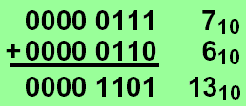
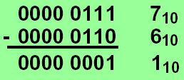
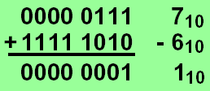
Addition & subtraction
Adding bit by bit, carries -> next digit
Subtraction
Directly
Addition of 2's complement

Slide 16
Overflow conditions
General overflow conditions
Operation | Operand A | Operand B | Result overflow
A+B | ≧0 | ≧0 | <0 (01)
A+B | <0 | <0 | ≧0 (10)
A-B | ≧0 | <0 | <0 (01)
A-B | <0 | ≧0 | ≧0 (10)
最高位和进位异或为1，则溢出

Slide 17
Overflow process
Hardware detection in the ALU
Generation of an exception (interrupt)
Save the instruction address (not PC) in special register EPC
Jump to specific routine in OS 异常处理
Correct & return to program
Return to program with error code回到出错的指令那里
Abort program

Slide 18
Which instructions cause Overflow
Overflows in signed arithmetic instructions cause exceptions:
add
add immediate (addi)
subtract (sub)
Overflows in unsigned arithmetic instructions don’t cause exceptions
add unsigned (addu)
add immediate unsigned (addiu)
Subtract unsigned (subu)
Handle with care!

Slide 19
Unsigned Binary Integers
Given an n-bit number
Range: 0 to +2^{n} – 1
Notes:
最低有效位（least significant bit）: 最右边
最高有效位（most significant bit）：最左边

Slide 20
2’s-Complement Signed Integers
Given an n-bit number
Range: –2^{n – 1} to +2^{n – 1} – 1
都是正数比负数少一位
–(–2^{n – 1}) can’t be represented
Some specific numbers
0: 0000 0000 … 0000
–1: 1111 1111 … 1111
Most-negative: 1000 0000 … 0000
Most-positive: 0111 1111 … 1111
Notes:
取反+1

Slide 21
RISC V instructions
Byte instructions
lbu: load byte unsigned 取无符号数字节
Loads a byte into the lowest 8 bit of a register
Fills the remaining bits with ‘0’ （一般32位计算机，8位需要补成32位）
Lb: load byte (signed)
Loads a byte into the lowest 8 bit of a register
Extends the highest bit最高位 into the remaining 24 bits
Set instructions for conditional branches
sltu: set on less than unsigned
slti: set on less than immediate
sltiu: set on less than unsigned immediate

Slide 22
Logical shift operations逻辑移位
right (srl)
left (sll)
Filled with '0'
Arithmetic shift operations算术移位
 | 码制 | 添加码
正数 | 原码、补码、反码 | 0
负数 | 原码 | 0
 | 补码 | 左移添0，右移添1
 | 反码 | 1
左移结果出错，右移精度下降

Slide 23
Logical operations
AND→bit-wise AND between registers
and register1, register2, register3
OR →bit-wise OR between registers
or register1, register2, register3
Example:
and $3, $10, $16
or $4, $10, $16
R16: 0000 0000 0000 0000 1100 1000 0000 1111
R10: 0000 0000 0000 0110 0100 0000 0111 1000
R3: 0000 0000 0000 0000 0100 0000 0000 1000
R4: 0000 0000 0000 0110 1100 1000 0111 1111

Slide 24
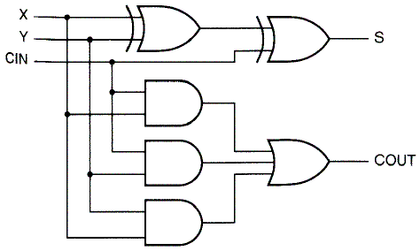
一位全加器
Full adder in 2-level design
+

Slide 25
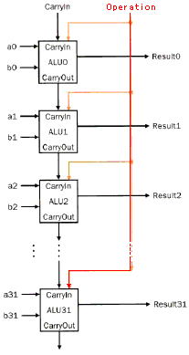
Basic 32 bit ALU
Inputs parallel
Carry is cascaded
Ripple carry adder
行波进位加法器
Slow, but simple
1st Carry In = 0

Slide 26
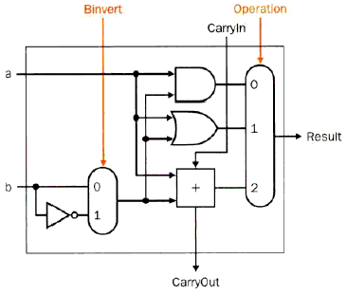
Extended 1 bit ALU
Subtraction
a - b
a-b = a + (~b+1)
=a + (-b)
Inverting b
1st CarryIn= 1

Slide 27
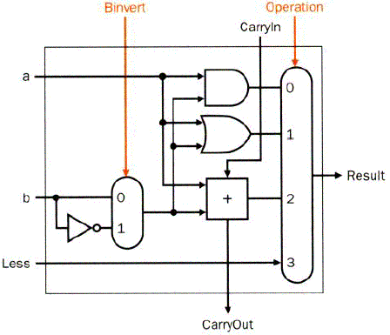
Extended 1 bit ALU to RISC V ALU
Functions
AND、OR、
Add、SUB
SLT、
Missing: comparison
Slt rd, rs1, rs2
If rs1 < rs2, rd=1, else rd=0
All bits = 0 except the least significant
Subtraction (rs1 – rs2), if the result is negative -> rs1 < rs2
Use of sign bit as indicator

Slide 28
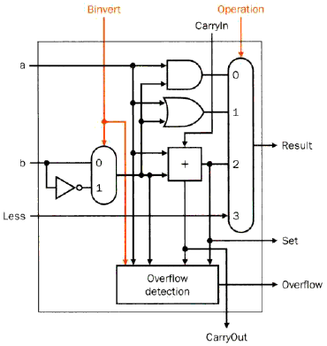
Most significant bit 检测溢出
Operation | Operand A | Operand B | Result overflow
A+B | ≧0 | ≧0 | <0 (01)
A+B | <0 | <0 | ≧0 (10)
A-B | ≧0 | <0 | <0 (01)
A-B | <0 | ≧0 | ≧0 (10)
least
significant bit
Most
significant bit

Slide 29
Complete ALU
Input
A
B
Control lines
Operation
Binvert
Carryin
Output
Result
Overflow

Slide 30
Complete ALU
输出比较结果
Add a Zero detector

Slide 31
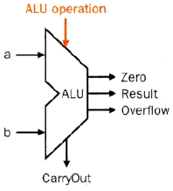
ALU 算术逻辑单元
ALU Control Lines | Function
000 | And
001 | Or
010 | Add
110 | Sub
111 | Set on less than
n位选择器，有 种操作

Slide 32

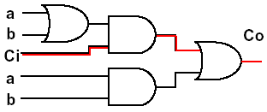
Speed considerations
A_{i}
Previously used: ripple carry adder行波
Delay for the sum: two units
Delay for the carry: two - three units
B_{i}
G_{i}
P_{i}
C_{i}
C_{i+1}
S_{i}

Slide 33
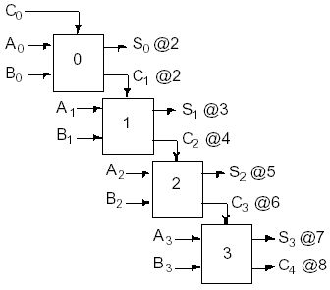
串行加法器
Delay of one adder
2 time units
Total delay for
stages:
2n unit delays

Slide 34
并行进位加法器 (CLA)
P
=
A
⊕
B
G
=
A
B
i
i
i
i
i
i
A_{i}
B_{i}
S
=
P
⊕
C
C
=
G
+
P
C
G_{i}
i
i
i
i
+
1
i
i
i
And,we can further get:
C1=G0+P0*c0 ;
C2= G1+P1*C1 = G1+P1*G0+ P1* P0*c0
C3=G2+P2*C2 = G2+P2*G1 + P2* P1*G0+ P2* P1* P0*c0
C4=G3+P3*C3= G3+P3*G2+P3*P2*G1+P3*P2*P1*G0+P3*P2*P1*P0*c0
P_{i}
C_{i}
C_{i+1}
S_{i}
Notes:
gi = ai * bi
pi = ai + bi

Slide 35
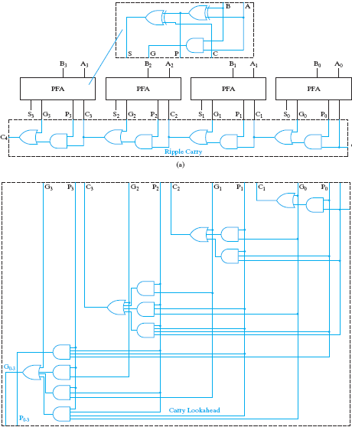
partial full adder

Slide 36
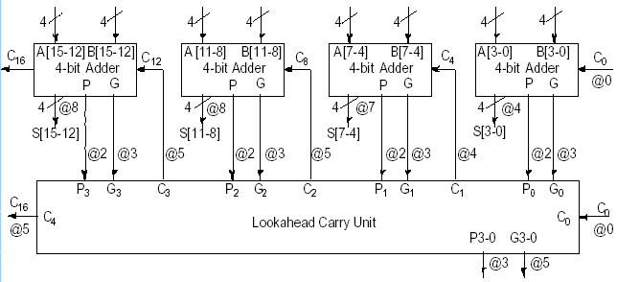
内部并行，组间串行
CLA
CLA
CLA
CLA
CLA

Slide 37
Carry-Skip Adders
With CMOS Implementation – Carry Skip Adder’s speed Comparable to CLA
Less Area/Power
Based on Observation that Carry Process Can “Skip” Stage for Which x_{i} ≠ y_{i} (that is p_{i} = x_{i}⊕y_{i} = 1)
Adder of n stages Divided into Stages of Selected Lengths
With Simple Ripple Carry
Each Group Generates “Group Carry-Propagate”=1 if all p_{i}=1 This Signal Allows Incoming Carry to “Skip” Stages within Group and Generate Carry-out

Slide 38
What does it mean if ALL Pi = 1 ?
c1 = g0 + (p0 * c0)
c2 = g1 + p1*c1 = g1 + (p1 * g0) + (p1 * p0 * c0)
c3 = g2 + p2*c2 = g2 + (p2 * g1) + (p2 * p1 * g0) + (p2 * p1 * p0 * c0)
c4 = g3 + p3*c3 = g3 + (p3 * g2) + (p3 * p2 * g1)
+(p3 * p2 * p1 * g0) + (p3 * p2 * p1 * p0 * c0)
gi = ai * bi pi= ai + bi
If Pi = 1 then it can be know that Gi = 0
So, c4 = g3 + p3*c3 = g3 + (p3 * g2) + (p3 * p2 * g1)
+(p3 * p2 * p1 * g0) + (p3 * p2 * p1 * p0 * c0)
= c0

Slide 39
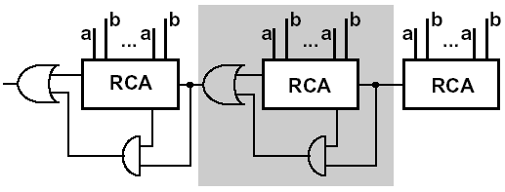
Carry skip adder
Accelerating the carry by skipping the interior blocks
Optimal speed with no-equal distribution of block length

Slide 40
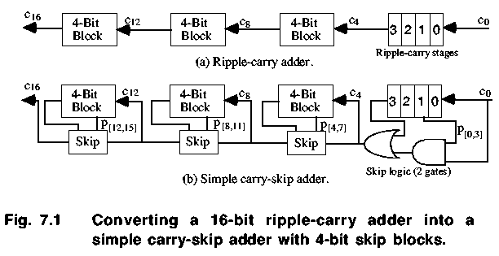
Fixed Block Width Carry-Skip Adders

Slide 41
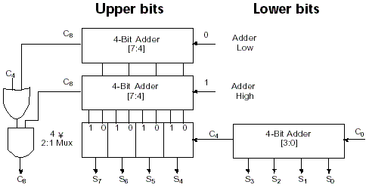
Carry Select Adder (CSA)
多路选择器

Slide 42
3 Multiplication

Slide 43
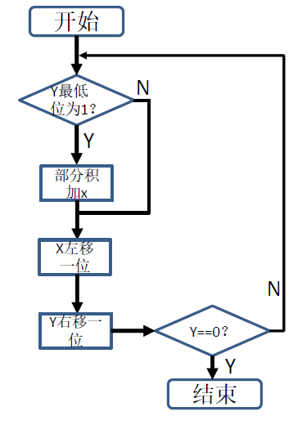
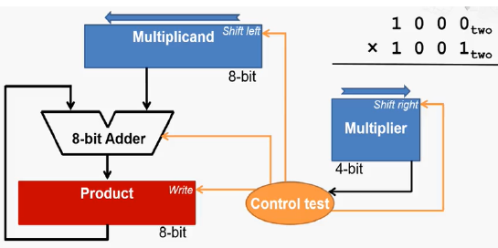
Multiplier V1
因为是两个 4 位数相乘 所以结果应该是四个数加和得到的 。 先判断 y 的最低位是 0 还是 1 如果是 1 则需要把 x 加到部分积上 若为 0 则需要把0 加到部分积上 实际上加 0 的这个过程计算机并不执行 因为加 0 对部分积没有任何影响 x 左移一位 之后再让 y 右移一位 若 y 为 0 则循环结束 否则继续此循环过程

Slide 44
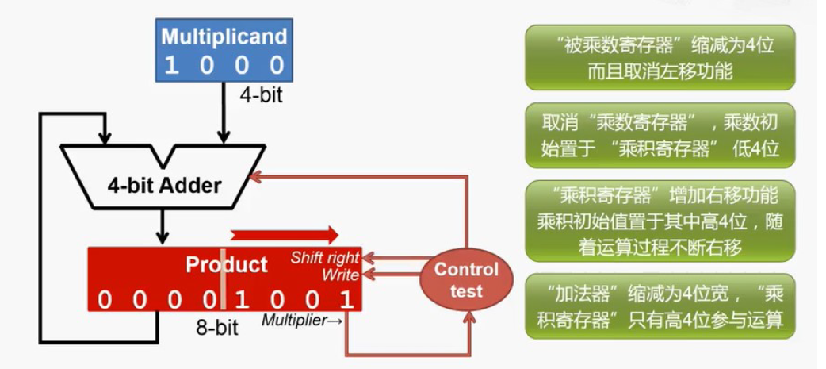
Multiplier V 2

Slide 45
Multiplier V 3
Further optimization
At the initial state the product register contains only '0'
The lower 32 bits are simply shifted out
Idea:
use these lower 32 bits for the multiplier

Slide 46
Multiplier V 3

Slide 47
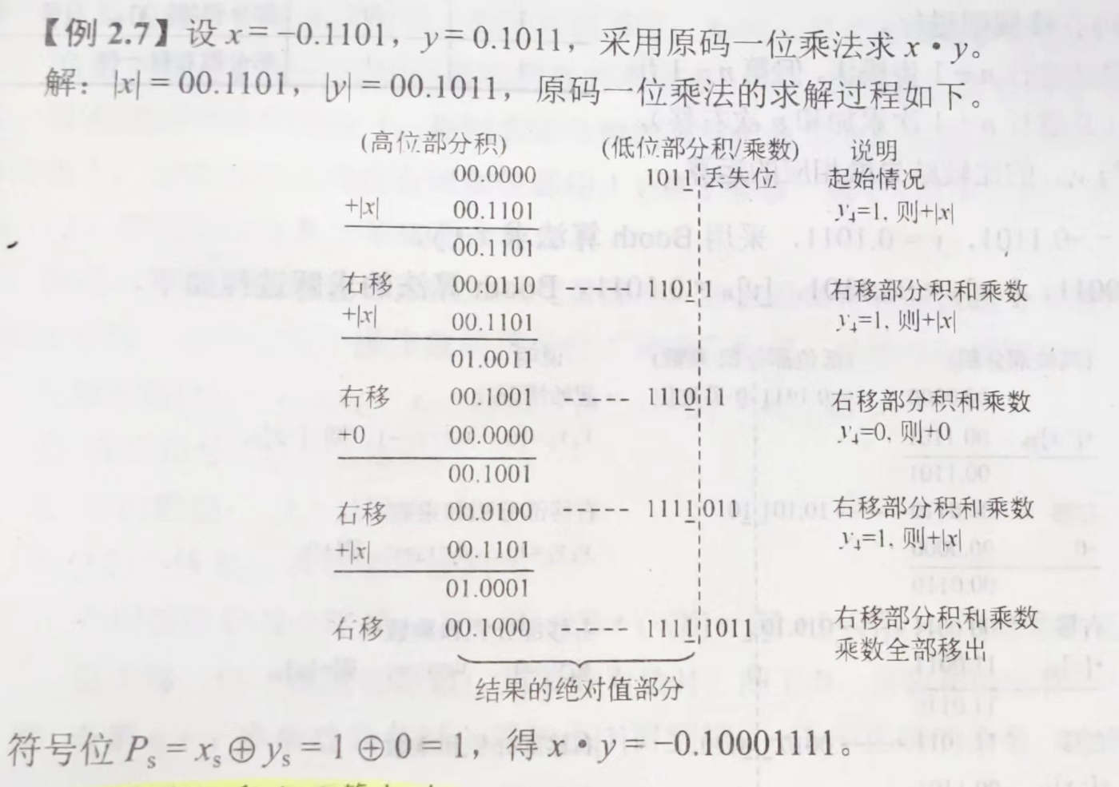
Signed multiplication符号数乘法
原码一位乘法
① 被乘数和乘数均取绝对值参与运算，看作无符号数，符号位为
②从乘数的最低位 开始判断，若 ，则部分积加上被乘数 ，然后右移一位；
若 则部分积加上0，右移一位

Slide 48
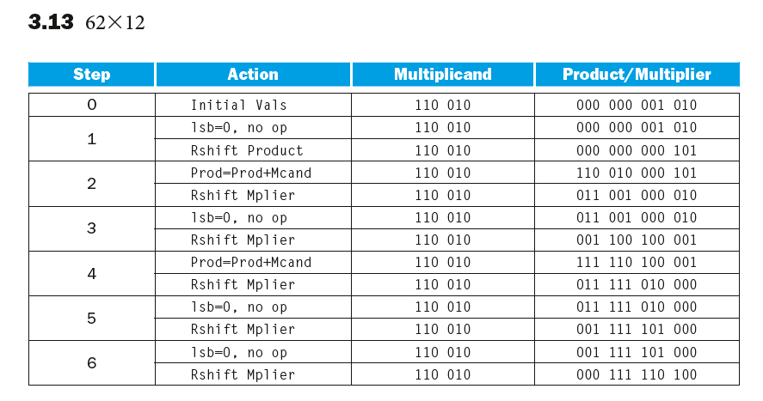
另一个例子

Slide 49
Booth's Algorithm
补码一位乘法
① 所有位都参与运算，结果也是补码
② 被乘数和部分积都取双符号位，初值为0，乘数取单符号位，并且末尾增设初值
③ 根据 来确定操作
④ 移位按照补码移位的规则
⑤ n+1次操作，n次右移
yn（高位） | yn+1（低位） | 部分积操作
0 | 0 | 右移1位
1 | 1
0 | 1 | 加[x]补，右移1位
1 | 0 | 加[-x]补，右移1位

Slide 50
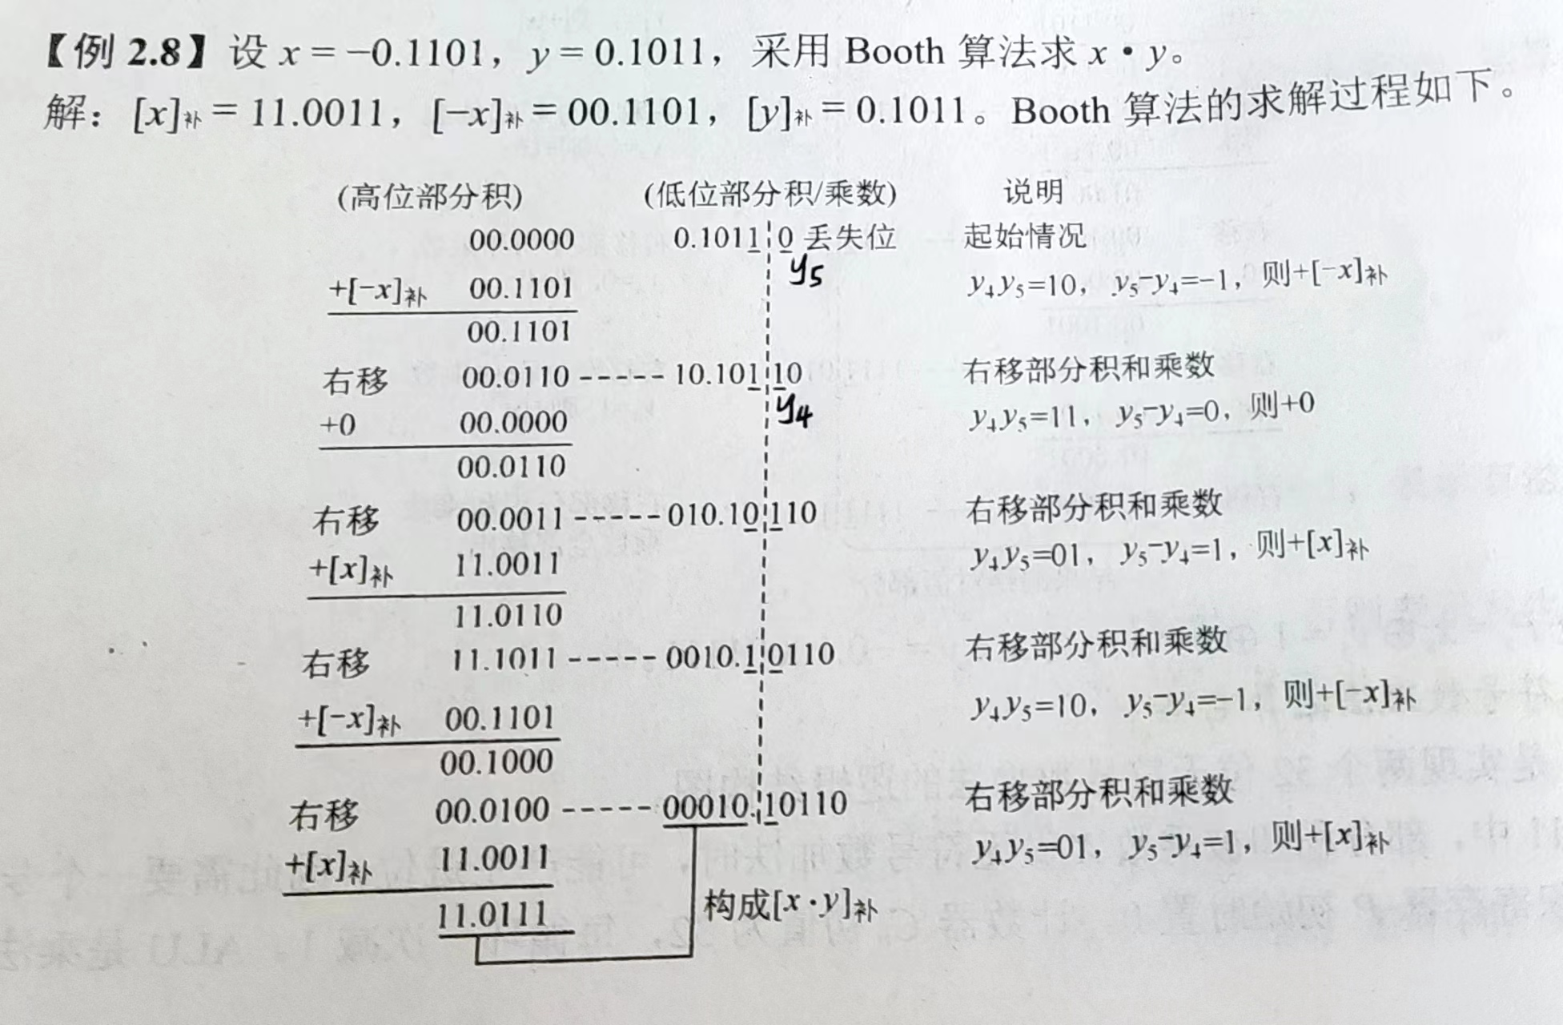
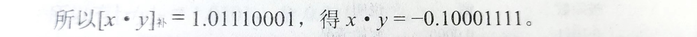

Slide 51
1比较多的时候好、0多的时候反而复杂了
Assumes： Z=y×10111100
Z=y(10000000+111100+100-100)
=y(1×2⁷+1000000-100)
=y(1×2⁷+1×2⁶-2²)
=y(1×2⁷+1×2⁶+0×2⁵+0×2⁴+0×2³+0×2²+0×2¹+0×2⁰ -1×2² )
= y(1×2⁷+1×2⁶+0×2⁵+0×2⁴+0×2³+0×2²-1×2² +0×2¹+0×2⁰)
= y×2⁷+y×1×2⁶+0×2⁵+0×2⁴+0×2³ +0×2²-y×2² +0×2¹+0×2⁰)
add
Only shift
sub
Only shift
1 01 111 10 00

Slide 52
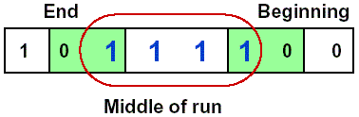
Booth's Algorithm
Idea: If you have a sequence of '1's
subtract at first '1' in multiplier
shift for the sequence of '1's
add where prior step had last '1‘
Result:
Possibly less additions and more shifts
Faster, if shifts are faster than additions
找一串1

Slide 53
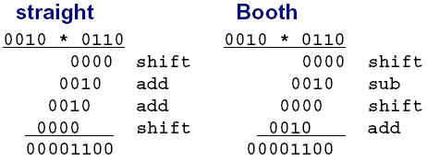
Booth's Algorithm
Example
Logic required identifying the run

Slide 54
Example with negative numbers
2 * (-3) = - 6
0010 * 1101 = 1111 1010
iteration | step | Multiplicand | product
0 | Initial Values | 0010 | 0000 1101 0
1 | 1.c:10→Prod=Prod-Mcand | 0010 | 1110 1101 0
 | 2: shift right Product | 0010 | 1111 0110 1
2 | 1.b:01→Prod=Prod+Mcand | 0010 | 0001 0110 1
 | 2: shift right Product | 0010 | 0000 1011 0
3 | 1.c:10→Prod=Prod-Mcand | 0010 | 1110 1011 0
 | 2: shift right Product | 0010 | 1111 0101 1
4 | 1.d: 11 → no operation | 0010 | 1111 0101 1
 | 2: shift right Product | 0010 | 1111 1010 1

Slide 55
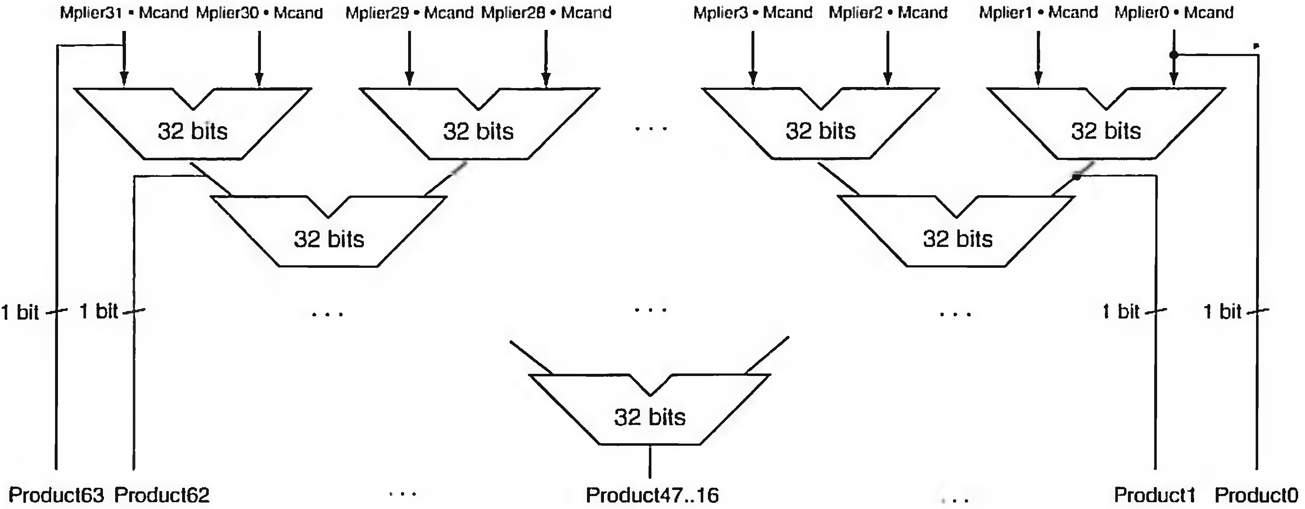
Faster Multiplication
分层设计

